Slide 1
Chapter 2
Data Preprocessing

Slide 2
What is an attribute?
An attribute is a property or characteristic of an object. Examples: eye color of a person, temperature, etc.
Attribute is also known as variable, field, characteristic, or feature
A collection of attributes describe an object. Object is also known as record, point, case, sample, entity, or instance.
Attribute values are numbers or symbols assigned to an attribute
Same attribute can be mapped to different attribute values. Example: height can be measured in feet or meters.
Different attributes can be mapped to the same set of values. Example: Attribute values for ID and age are integers but properties of attribute values can be different. ID has no limit but age has a maximum and minimum value.

Slide 3
Types of Attributes ( Approach 1)
Attribute Type | Description | Examples
Nominal | The values of a nominal attribute are just different names, i.e., nominal attributes provide only enough information to distinguish one object from another. (=, ≠) | zip codes, employee ID numbers, eye color.
Ordinal | The values of an ordinal attribute provide enough information to order objects. (<, >) | hardness of minerals, {good, better, best}, grades, street numbers
Interval | For interval attributes, the differences between values are meaningful, i.e., a unit of measurement exists. (+, - ) | calendar dates, temperature in Celsius or Fahrenheit
Ratio | For ratio variables, both differences and ratios are meaningful. (*, /) | temperature in Kelvin, monetary quantities, counts, age, mass, length, electrical current

Slide 4
Types of Attribute (Approach 2)
Discrete Attribute
Has only a finite or countable infinite set of values
Examples: zip codes, counts, or the set of words in a collection of documents
Often represented as integer variables.
Note: binary attributes are a special case of discrete attributes
Continuous Attribute
Has real numbers as attribute values
Examples: temperature, height, or weight.
Practically, real values can only be measured and represented using a finite number of digits.
Continuous attributes are typically represented as floating-point variables.

Slide 5
Types of Attribute (Approach 3)
Character
values are represented in forms of character or set of characters (string).
Number
values are represented in forms of number. Number may be in form of whole number, decimal number.

Slide 6
Types of data sets
Record
Data that consists of a collection of records, each of which consists of a fixed set of attributes
Data Matrix
If data objects have the same fixed set of numeric attributes, then the data objects can be thought of as points in a multi-dimensional space, where each dimension represents a distinct attribute
Such data set can be represented by an m by n matrix, where there are m rows, one for each object, and n columns, one for each attribute
Projection of x Load | Projection of y load | Distance | Load | T hickness
10.23 | 5.27 | 15.22 | 2.7 | 1.2
12.65 | 6.25 | 16.22 | 2.2 | 1.1

Slide 7
Types of data sets
Document Data
Each document becomes a `term' vector, each term is a component (attribute) of the vector, the value of each component is the number of times the corresponding term occurs in the document
 | team | coach | Play | ball | score | game | wi n | lost | timeout | season
Document 1 | 3 | 0 | 5 | 0 | 2 | 6 | 0 | 2 | 0 | 2
Document 2 | 0 | 7 | 0 | 2 | 1 | 0 | 0 | 3 | 0 | 0
Document 3 | 0 | 1 | 0 | 0 | 1 | 2 | 2 | 0 | 3 | 0

Slide 8
Types of data sets
Transaction Data
A special type of record data, where each record (transaction) involves a set of items.
For example, consider a grocery store. The set of products purchased by a customer during one shopping trip constitute a transaction, while the individual products that were purchased are the items
TID |  | Items
1 |  | Bread, Coke, Milk
2 |  | Beer, Bread
3 |  | Beer, Coke, Diaper, Milk
4 |  | Beer, Bread, Diaper, Milk
5 |  | Coke, Diaper, Milk

Slide 9
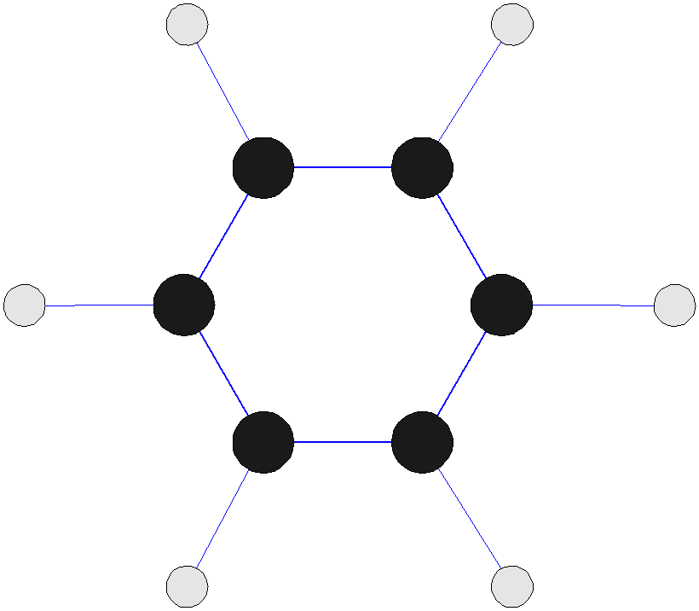
Types of data sets
Graph
Contains notes and connecting vertices

Slide 10
Types of data sets
Ordered
Has Sequences of transactions
Spatial Data
Spatial data, also known as geospatial data, is information about a physical object that can be represented by numerical values in a geographic coordinate system.
Temporal Data
A temporal data denotes the evolution of an object characteristic over a period of time. Eg d=f(t).
Sequential Data
Data arranged in sequence.

Slide 11
Important Characteristics of Structured Data
Dimensionality
A Data Dimension is a set of data attributes pertaining to something of interest to a business. Dimensions are things like "customers", "products", "stores" and "time".
Curse of Dimensionality
When dimensionality increases, data becomes increasingly sparse in the space that it occupies.
Definitions of density and distance between points, which is critical for clustering and outlier detection, become less meaningful
*Purpose:
Avoid curse of dimensionality
Reduce amount of time and memory required by data mining algorithms
Allow data to be more easily visualized
May help to eliminate irrelevant features or reduce noise
*Techniques
Principle Component Analysis
Singular Value Decomposition
Others: supervised and non-linear techniques

Slide 12
Dimensionality Reduction:
PCA
Goal is to find a projection that captures the largest amount of variation in data.
Find the eigenvectors of the covariance matrix.
The eigenvectors define the new space.
Construct a neighborhoods graph
For each pair of points in the graph, compute the shortest path distances – geodesic distances
Feature Subset Selection
Another way to reduce dimensionality of data.
Redundant features.
Duplicate much or all of the information contained in one or more other attributes.
Example: purchase price of a product and the amount of sales tax paid.
Irrelevant features
Contain no information that is useful for the data mining task at hand
Example: students' ID is often irrelevant to the task of predicting students' GPA

Slide 13
Dimensionality Reduction:
Techniques:
Brute-force approach:
Try all possible feature subsets as input to data mining algorithm
Embedded approaches:
Feature selection occurs naturally as part of the data mining algorithm
Filter approaches:
Features are selected before data mining algorithm is run
Wrapper approaches:
Use the data mining algorithm as a black box to find best subset of attributes.
Feature Creation
Create new attributes that can capture the important information in a data set much more efficiently than the original attributes.
Three general methodologies:
Feature Extraction: domain-specific
Mapping Data to New Space
Feature Construction: combining features

Slide 14
Sparsity and Density
Sparsity and density are terms used to describe the percentage of cells in a database table that are not populated and populated, respectively. The sum of the sparsity and density should equal 100.
Many of the cell combinations might not make sense or the data for them might be missing.
In the relational world storage of such data is not a problem: we only keep whatever there is. If we want to keep closer to our multidimensional view of the world, we face a dilemma: either store empty space or create an index to keep track of the nonempty cells or search for an alternative solution

Slide 15
Data Quality
Real world database are highly unprotected from noise, missing and inconsistent data due to their typically huge size and their possible origin from multiple, heterogeneous sources.
Low quality data will lead to low quality mining results.
Data pre-processing is required to handle these above mentioned facts.
The methods for data preprocessing are organized into
Data Cleaning
Data Integration
Data Transformation
Data Reduction
Data Discritization

Slide 16
Data Cleaning
Mostly concern with
Fill-in missing values
Identify outliers and smooth out noisy data
Correct inconsistent data
Eliminate duplicate data
Missing Data
Data is not always available because many tuples may not have recorded values for several attributes such as age, income.
Missing data may be due to:
Equipment Malfunction
Inconsistent with other recorded data and thus deleted.
Data not entered due to misunderstanding
Certain data may not be considered important at the time of entry.
No change in recorded data.

Slide 17
How to Handle Missing Data?
Ignore the tuple: usually done when class label is missing. Not effective when the percentage of missing values per attribute varies considerably.
Fill-in missing values manually: Tedious and infeasible task.
Use a global constant to fill-in missing values.
Use an attribute mean fill-in missing values belonging to the same class.
Use the most probable value to fill-in missing value.

Slide 18
Noisy Data
Noisy data is a form of error because of random error in a measured variable.
Incorrect attribute values may be due to:
Faulty data collection instruments
Data entry problem
Data transmission problem
Technology limitation
Inconsistency in naming convention
How to Handle Noisy Data
Clustering: Detect and remove outliers
Regression: Smooth by fitting the data into regressi9on function
Binning Method: First sort the data and partition into different boundaries with mean, median values.
Combined computer and human inspection, doing so suspicious values are detected by human

Slide 19
Outliers
Outliers are a set of data points that are considerably dissimilar or inconsistent with the remaining data.
In most of the cases they are inference of noise while in some cases they may actually carry valuable information.
Outliers can occur because of:
Transient malfunction of data measurement
Error in data transmission or transcription
Changes in system behavior
Data contamination from outside the population examined.
Flaw in assumed theory

Slide 20
Outliers
How to Handle Outliers
There are three fundamental approaches to the problem of outlier’s detection
Type 1:
Determine the outliers with no prior knowledge of data. This is a learning approach analogous to unsupervised learning.
Type 2:
Model with normality and abnormality. Analogous to supervised learning.
Type 3:
Model with normality. Semi- supervised learning approach

Slide 21
Data Integration
Combines data from multiple sources into a coherent store.
Integrate meta data from different sources (Schema Integration)
Problem: - Entity Identification Problem.
Different sources have different values for same attributes.
Data Redundancy
These problems are mainly because of different representation, different scales etc.
How to handle redundant data in data integration?
Redundant data may be able to be detected by correlation analysis.
Step-wise and careful integration of data from multiple sources may help to improve mining speed and quality.

Slide 22
Data Transformation
Changing data from one form to another form.
Approaches:
Smoothing: Remove noise from data.
Aggregation: Summarizations of data
Generalization: Hierarchy climbing of data
Normalization: Scaled to fall within a small specified range.
Types
Min-Max Normalization:
V’ = ((V-min)/(max-min)* (new_max – new_min)) + new_min
Z-Score Normalization:
V’ = (V-min)/ stand_dev.
Normalization by decimal scaling:
V’= V/ 10^{j} where j is the smallest integer such that max (|V’|) <1

Slide 23
Data Aggregation:
Combining two or more attributes (or objects) into a single attribute (or object).
Purpose
Data reduction: Reduce the number of attributes or objects
Change of scale: Cities aggregated into regions, states, countries, etc
More “stable” data: Aggregated data tends to have less variability

Slide 24
Data Reduction:
Warehouse may store terabytes of data hence complex data mining may take a very long time to run on complete data set.
Data reduction is the process of obtaining a reduced representation of data set that is much smaller in volume but yet produces the same or almost same analytical results.
Different methods such as data sampling, dimensionality reduction, data cube, aggregation, discritization and hierarchy are used for data reduction.
Data compression can also be used mostly in media files or data.

Slide 25
Data Sampling:
It is one of main method for data selection
It is often used for both the preliminary investigation of the data and the final data analysis.
Statisticians sample because obtaining the entire set of data of interest is too expensive or time consuming.
Sampling is used in data mining because processing the entire set of data of interest is too expensive or time consuming.
Often used for both preliminary investigation of data and the final data analysis.
Important since obtaining entire set of data of interest is too expensive or time consuming.
Sampling should be representative since it must represent approximately the same property as the original set of data.

Slide 26
Sampling types
Simple Random Sampling: Equal probability of selecting any particular item.
Sampling without replacement: As each item is selected, it is removed from population.
Sampling with replacement: Objects are not removed from the population as they are selected from the sample. The same objects can be picked-up more than once.
Stratified Sampling: Split the data into several partitions, then draw random samples from each partition.

Slide 27
Data Discretization
Convert continuous data into discrete data.
Partition data into different classes.
Two approaches are:
Equal width (distance) partitioning:
It divides the range into N intervals of equal size.
If A and B are the lowest and the highest values of the attribute, the width of interval will be
W = (A – B)/N.
The most straight forward approach for data discretization.
Equal depth (frequency) partitioning:
It divides the range into N intervals, each containing approximately same number of samples.
Good data scaling
Managing categorical attributes can be tricky.

Slide 28
OLAP
OLAP stands for On-Line Analytical Processing.
An OLAP cube is a data structure that allows fast analysis of data.
OLAP tools were developed to solve multi-dimensional data analysis which stores their data in a special multi-dimensional format (data cube) with no updating facility.
An OLAP toll doesn’t learn, it creates no new knowledge and they can’t reach new solutions.
Information of multi-dimension nature can’t be easily analyzed when the table has the standard 2-D representation.
A table with n- independent attributes can be seen as an n-dimensional space.
It is required to explore the relationships between several dimensions and standard relational databases are not very good for this.

Slide 29
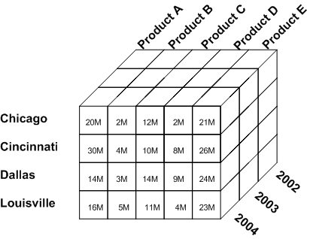
OLAP Tool

Slide 30
OLAP Operations
Slicing: A slice is a subset of multi-dimensional array corresponding to a single value for one or more members of the dimensions. Eg: Product A sales.
Dicing: Dicing operation is the slice on more than two dimensions of data cube. (More than two consecutive slice). Eg: Product A sales in 2004.
Drill-Down: Drill-down is specific analytical technique where the user navigates among levels of data ranging from the most summarized to the most detailed i.e. it navigates from less detailed data to more detailed data. Eg: Product A sales in Chicago in 2004.
Roll-Up: Computing of all the data relationship for more than one or more dimensions i.e. summarization of data to one o more dimensions. Eg: Total Product.
Pivoting: Pivoting is also called rotate operation. It rotates the data in order to provide an alternative presentation of data.

Slide 31
OLTP (Online Transaction Processing)
Used to carry out day to day business functions such as ERP (Enterprise Resource Planning), CRM ( Customer Relationship Planning)
OLTP system solved a critical business problem of automating daily business functions and running real time report and analysis.

Slide 32
OLAP Vs OLTP
Facts | OLTP | OLAP
Source of Data | Operational Data | Data warehouse (From various database)
Purpose of data | Control and run fundamental business tasks | For planning, problem solving and decision support
Queries | Simple queries | Complex queries and algorithms
Processing Speed | Typically very fast | Depends on data size, techniques and algorithms
Space requirements | Can be relatively small | Larger due to aggregated databases
Database Design | Highly Normalized with many tables. | Typically denormalized with fewer tables. Use of star or snowflake schema.

Slide 33
Similarity and Dissimilarity of OLAP and OLTP
Similarity
Numerical measure of how alike two data objects are.
Is higher when objects are more alike.
Often falls in the range [0,1]
Dissimilarity
Numerical measure of how different are two data objects
Lower when objects are more alike
Minimum dissimilarity is often 0
Upper limit varies

